Slide 1

Predicting Flight Satisfaction with Neural Networks
We're a startup revolutionizing customer satisfaction in the airline industry with our advanced Dense Neural Network model.
Group 8

Slide 2

Business Model & Market Opportunity
The problem:
Customers often have poor flying experinces due to inconsistent service quality.
Airlines can struggle heavily due to Low satisfaction scores, customer disloyalty, and negative reviews.
Airline sector currently uses survey data post-flight, and complaint logs, a reactive rather than preventitive approach.

Slide 3

The Solution → Predictive Model DNN
A Dense Neural Network that predicts customer satisfaction based on numerous factors.
Airlines become proactive in taking action to improve service, reduce churn, and enhance customer loyalty

Slide 4





How will Airlines
become Proactive?
Predictive Insights
Pain Point Identification
Predictive Service Enhancements
Boost Profitability

Slide 5
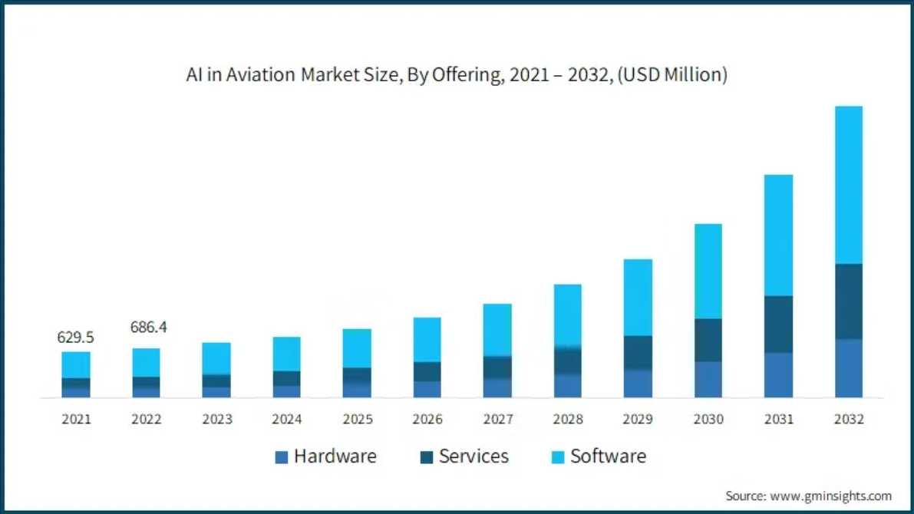
Market & Competitive Landscape
Open-Source Models: Not personalized, developers
needed
In-house Data Analytics teams: Fulltime, long time
horizons for projects

Slide 6

Customer & Stakeholders
1
Airlines
Key decision makers (CEO and higher mangement)
Customer service teams
2
Airport Operators
3
Regulators & industry bodies
4
Passengers

Slide 7




Marketing Strategy
Digital marketing through LinkedIn, industry blogs, and aviation analytics websites.
Partnerships with airline industry forums, aviation conferences, and travel-tech expos.
Direct B2B sales approach targeting customer experience managers at airlines.

Slide 8

Revenue Strategy
Consultation/ Partnerships
API/ Online usage
Contract based, fixed term partnerships and customized development
Subsciption based method

Slide 9
Section 2:
Neural Network Development & Performance

Slide 10
Process Overview
Flight Data Input
1
We gather a vast range of flight data, including delays, cancellations, baggage handling, and in-flight service.
Dense Neural Network
2
Our dense neural network processes this data through multiple layers, extracting complex relationships and patterns.
Satisfaction Prediction
3
The final layer outputs a probability score, indicating the likelihood of a customer's satisfaction.
4
Real time Dashboard recommendations
Produce real time recommendations and flags potential service inconsistency.

Slide 11
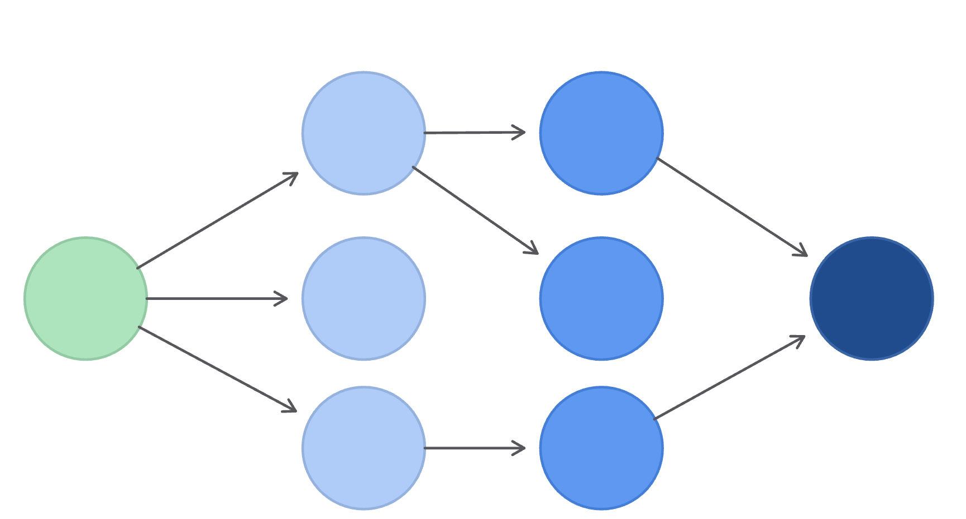
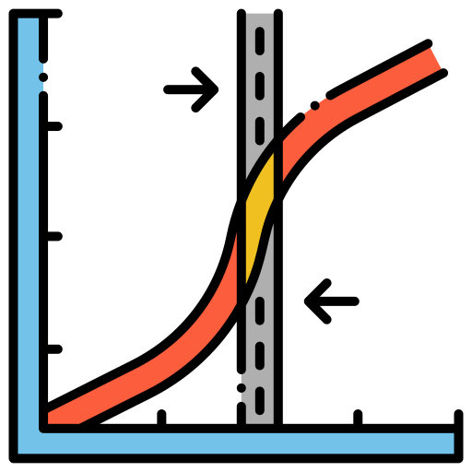

Model Performance and Key metrics
Logistic regression
Dense Neural Network
87.73%
96.44%
F1 score: 0.8770
F1 Score: 0.9590
AUC Score: 0.8730
AUC: 0.9954
43%
Satisfaction rate in Data

Slide 12
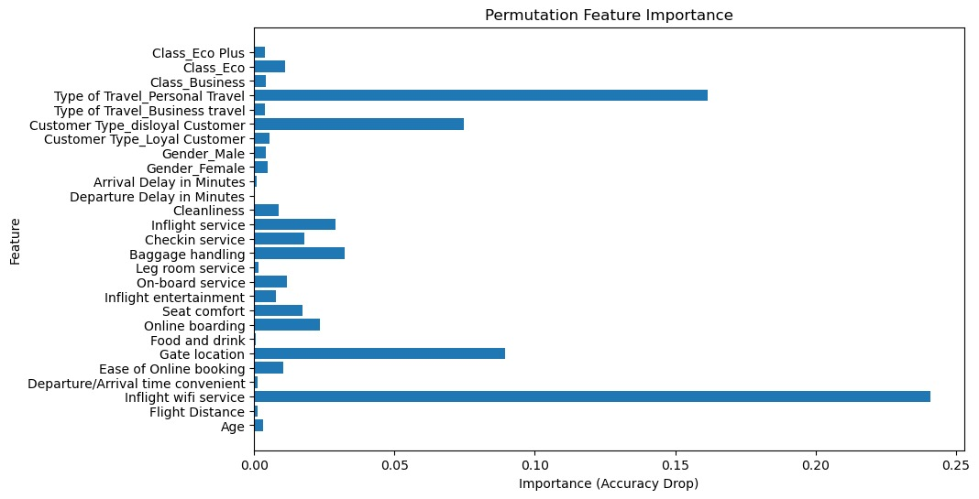
Feature Importance Analysis

Slide 13

Future Data needs for Development
1
Passenger Feedback Data
Gathering feedback from surveys, and complaint logs
2
Passenger Profile Data
Leveraging passenger information, and prediction models to forecast customer satisfaction scores.
3
Flight Operations Data
Collecting data on flight schedules, delays, cancellations, and operational efficiency.

Slide 14
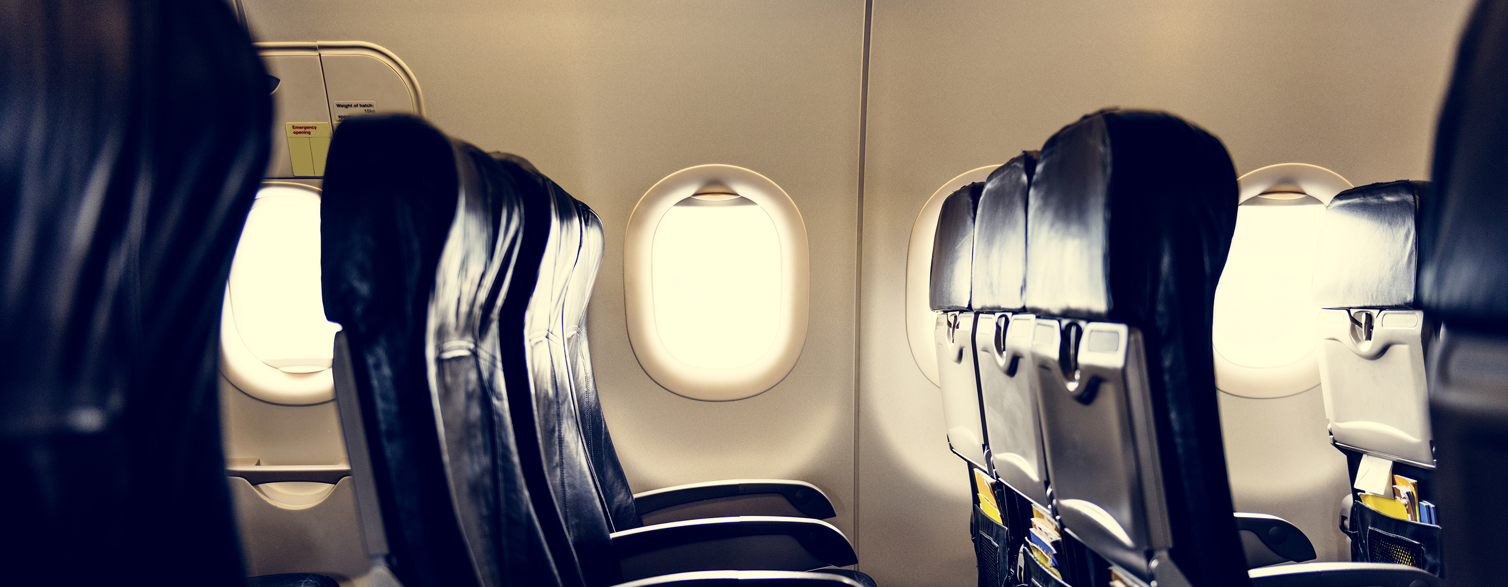
Join us in revolutionizing customer experience
Seeking investment for pilot deployment with an airline
Strategic partners & early adopters

